Slide 1

Year 2 Maths Parent Workshop
Monday 27th April 2026

Slide 2
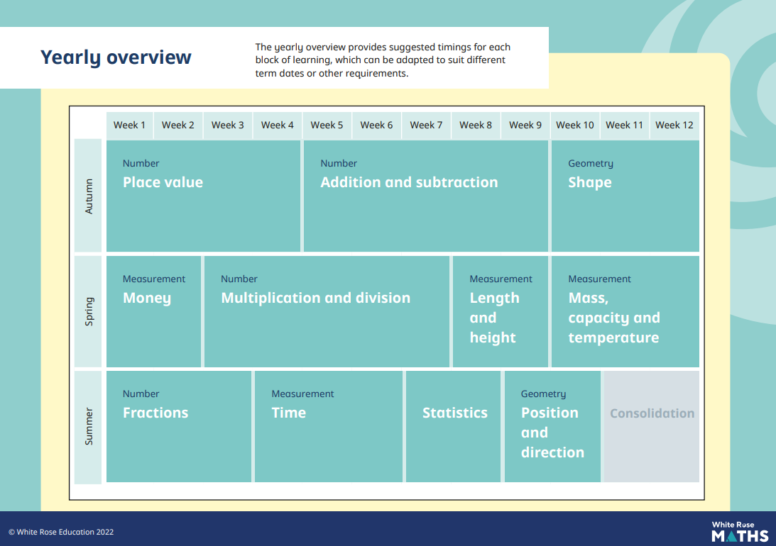

Slide 3
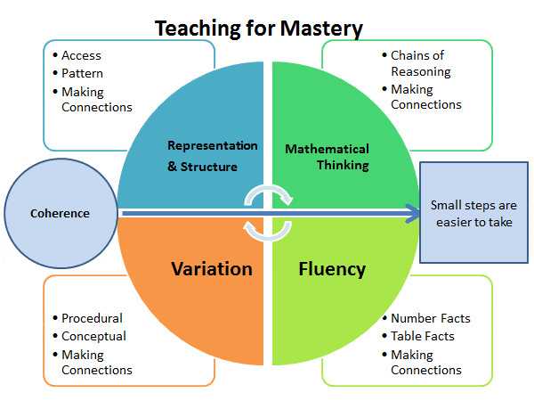
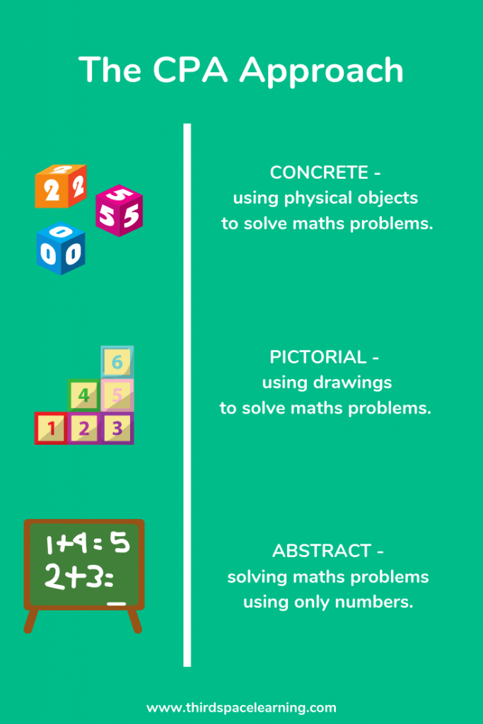
Useful websites:
White Rose Maths , Third Space Learning,
NCETM (National Centre for Excellence in the Teaching of Maths)

Slide 4
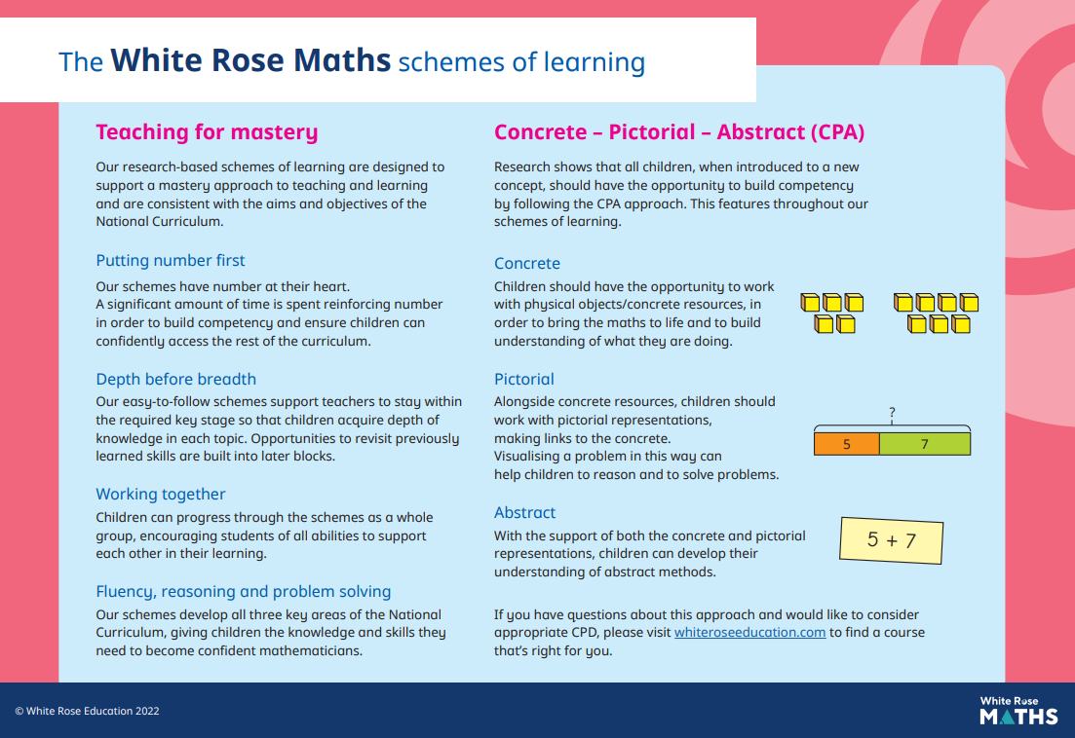

Slide 5
Concrete
This allows the children to use physical concrete manipulatives to support them with their maths skills. It will enable them to visualise and move the objects around which will help them to understand what they are doing and learning. It will bring the maths to life.

Slide 6
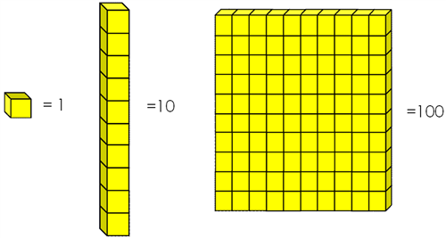

Slide 7
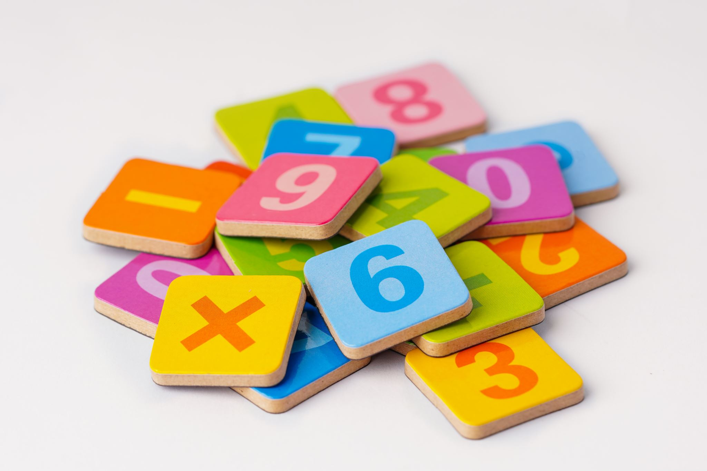
Since we last met, the children have grasped place value, addition and subtraction, shape, money, multiplication and division, length and height, mass, capacity and temperature.
At present, we are learning all about fractions.

Slide 8
To support the children’s learning and to embed skills, it’s good to begin each topic using the concrete, pictorial and then abstract, where we can then use the skills that have been embedded and taught – fluency – in a particular topic. This supports them to give reasons and solve problems using their fluency skills.

Slide 9

SHAPE - How many vertices does the 2D shapes have?
Vertices are Where 2 sides meet to make a corner
What are vertices?

Slide 10
Can you draw 2 different types of…?
triangles
squares
rectangles
hexagons
Pentagons
Can you explain why it is the shape you have drawn?
Can you draw a vertical line of symmetry on the shapes you have?

Slide 11
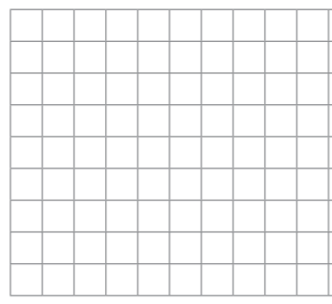


Each diagram shows half a shape and a line of symmetry.
How would you complete the shape?
How do you know if the drawing is symmetrical?
Have a think

Slide 12
3D shapes

Slide 13
Here is a cuboid.
Have a think
1
1
5
2
6
2
5
6
3
3
4
4
What do you notice?
What 2-D shapes do you see?

Slide 14
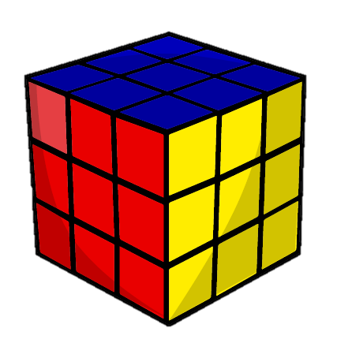





How can you sort these objects?
No curved surfaces
Curved surfaces
Have a think
Choose 6 objects.
How can you sort your objects?

Slide 15
MUILTIPLICATION AND DIVISION
This unit starts with making and adding equal groups.
Then introducing the multiplication symbol and writing number sentences.
Using arrays.
Making equal groups by grouping.
Making equal group by sharing.
Then works through the 2, 5 and 10 times-table, alongside its division.

Slide 16
Here are 12 counters.
Make 4 groups of 3
Have a think

Slide 17
Here are 12 counters.
Have a think
Make 3 groups of 4
What other equal groups could you make?
Have a think

Slide 18
Here are 12 counters.
12 groups of 1
2 groups of 6
6 groups of 2
1 group of 12
What other equal groups could you make?

Slide 19
With 12, you can make many equal groups. Do the children recognise what it means? How many groups/lots with X in each group?
4 groups of 3 – 3 + 3 + 3 + 3 = 12 meaning 4 x 3 = 12
3 groups of 4 – 4 + 4 + 4 = 12 meaning 3 x 4 = 12
2 groups of 6 – 6 + 6 = 12 meaning 2 x 6 = 12
6 groups of 2 – 2 + 2 + 2 + 2 + 2 + 2 = 12 meaning 6 x 2 = 12
1 group of 12 – 12 + 0 =12 meaning 1 x 12 = 12
12 groups of 1 – 1 + 1 + 1 + 1 + 1 + 1 + 1 + 1 + 1 + 1 + 1 + 1 = 12 meaning 12 x 1 = 12

Slide 20
The children will come across mathematical language such as repeated addition, inverse, related facts.
PRACTICAL
Let’s have a go at investigating some of these numbers:
10 18 16 21
How many different equal groups can you make for each number?
Can you write the repeated addition and multiplication sentence?

Slide 21
When we are drawing equal groups, we may draw something like the image above.
However, an array may help us to count counters easier.

Slide 22
An array
Made up of equal rows and columns
columns
rows

Slide 23



Tiny is making arrays.
Which of Tiny’s arrays are correct?
Have a think

Slide 24
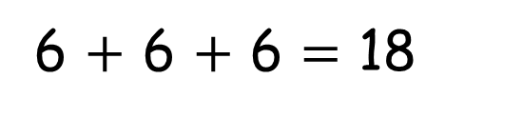

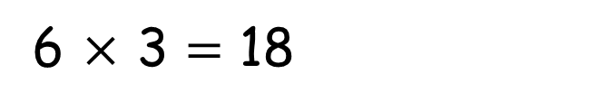
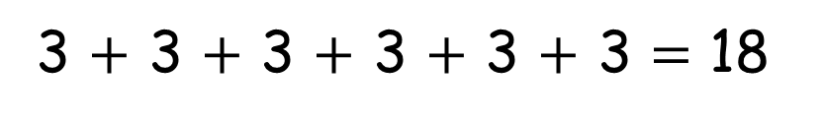
How can you write the number sentences another way?
6 $+$ 6 $+$ 6 $=$ 18
3 $×$ 6 $=$ 18
3 $+$ 3 $+$ 3 $+$ 3 $+$ 3 $+$ 3 $=$ 18
6 $×$ 3 $=$ 18

Slide 25
Arrays
Use the Base 10 to make and draw an array for the following number sentences:
5 x 3 4 x 2 3 x 6
Can you make at least two different arrays with the following numbers:
15 14 8 20
We then move onto grouping and sharing.

Slide 26









The children are put into teams of 4
How many teams will there be?
2 teams
Complete the division.
$÷$ $=$
8
4
2
Have a think

Slide 27
The children are put into teams of 2
How many teams will there be?
4 teams
Complete the division.
$÷$ $=$
8
2
4
Have a think

Slide 28
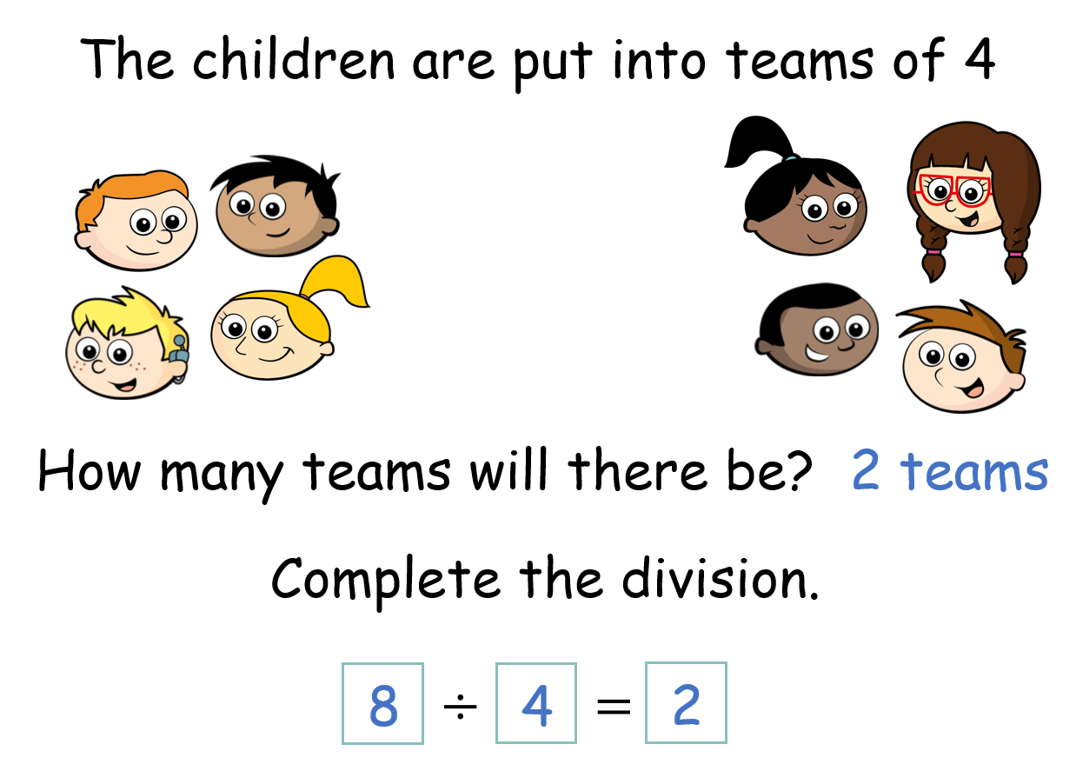
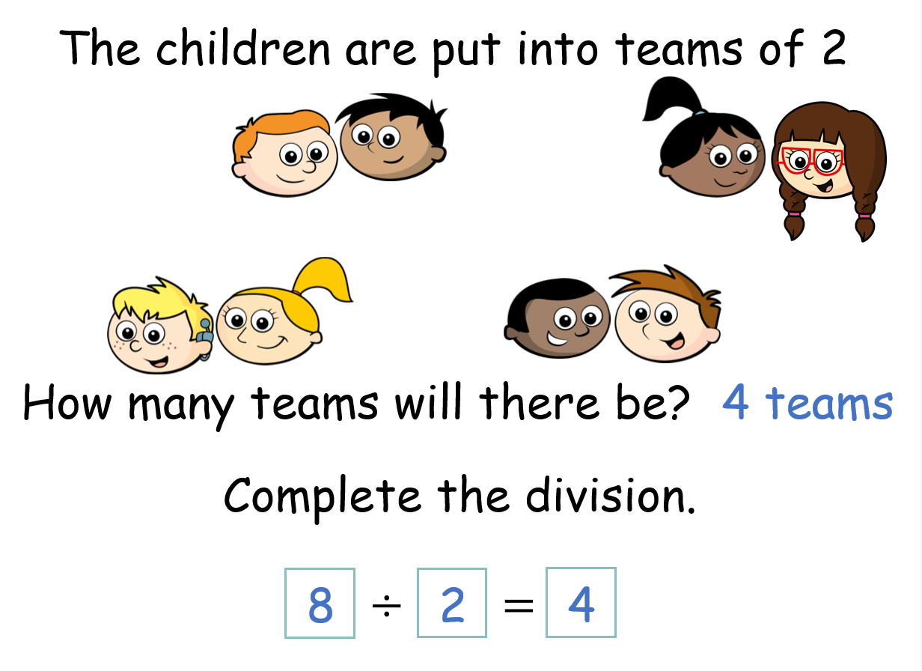
What is the same?
What is different?

Slide 29
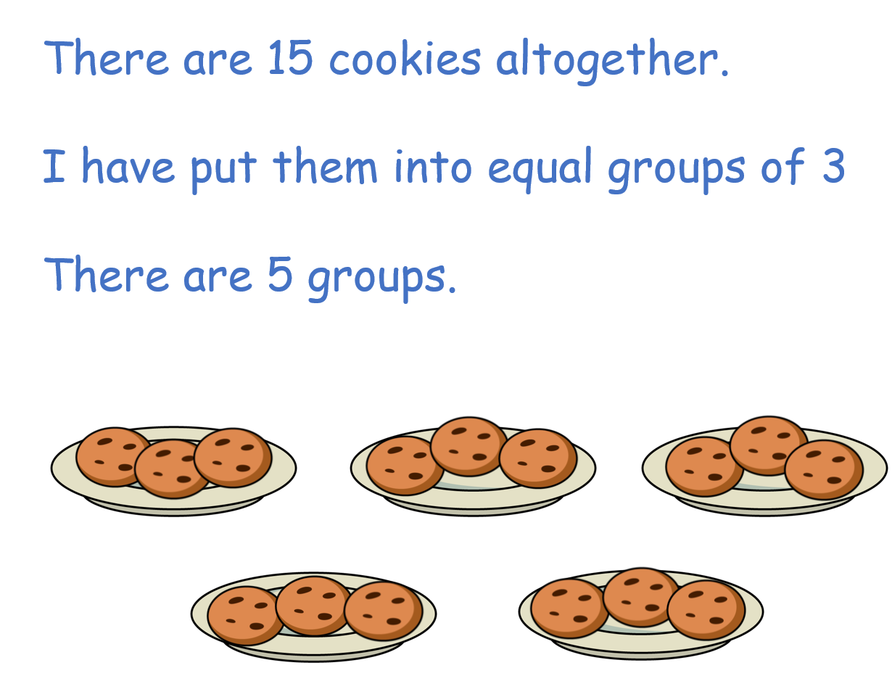
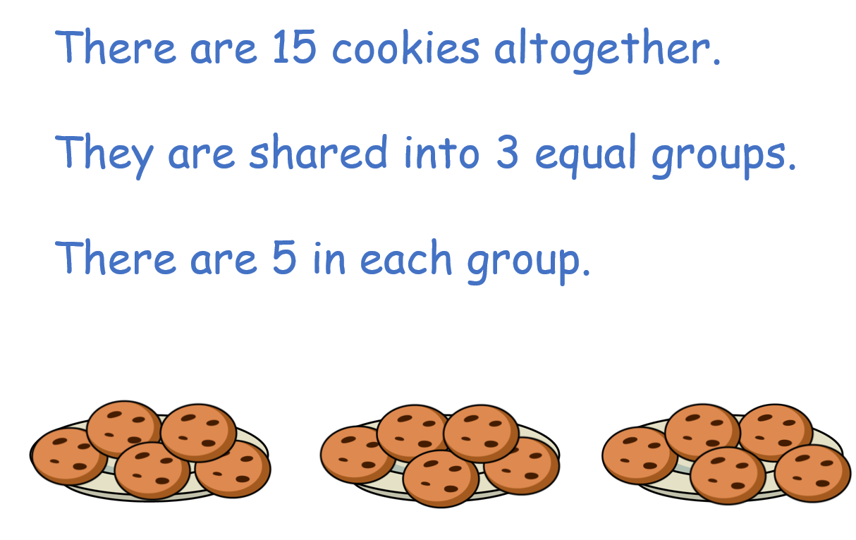
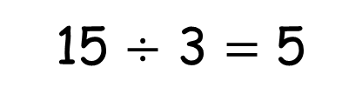
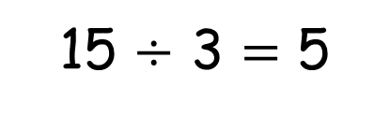
Grouping
15 $÷$ 3 $=$ 5
total
number of groups
number in each group
Sharing
15 $÷$ 3 $=$ 5
total
number in each group
number of groups

Slide 30

Try these with the Base 10 by grouping and sharing:
12 $÷$ 4 $=$
14 $÷$ 2 $=$
15 $÷$ 3 $=$
20 $÷$ 5 $=$
You can work out which method you prefer to use to work out the answers.
The answers will be the same, but the pictorial will be different.

Slide 31
Each topic will always be taught using the concrete to enable the children to grasp the concept and their fluency skills.
Once embedded, they can use their fluency to move onto the abstract and complete reasoning and problem-solving tasks.

Slide 32
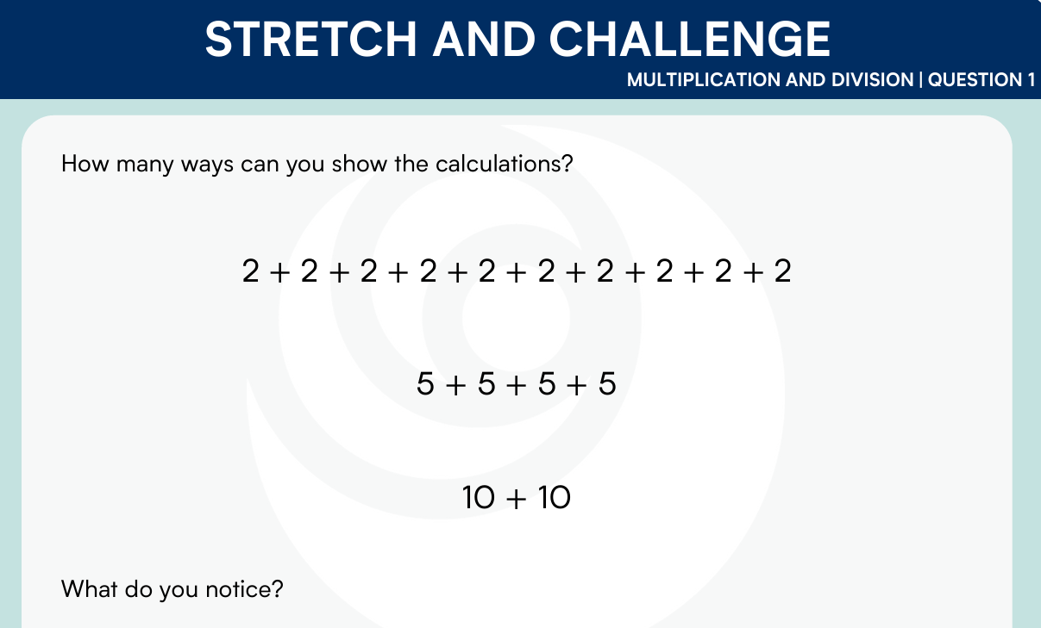
Reasoning and Problem Solving

Slide 33
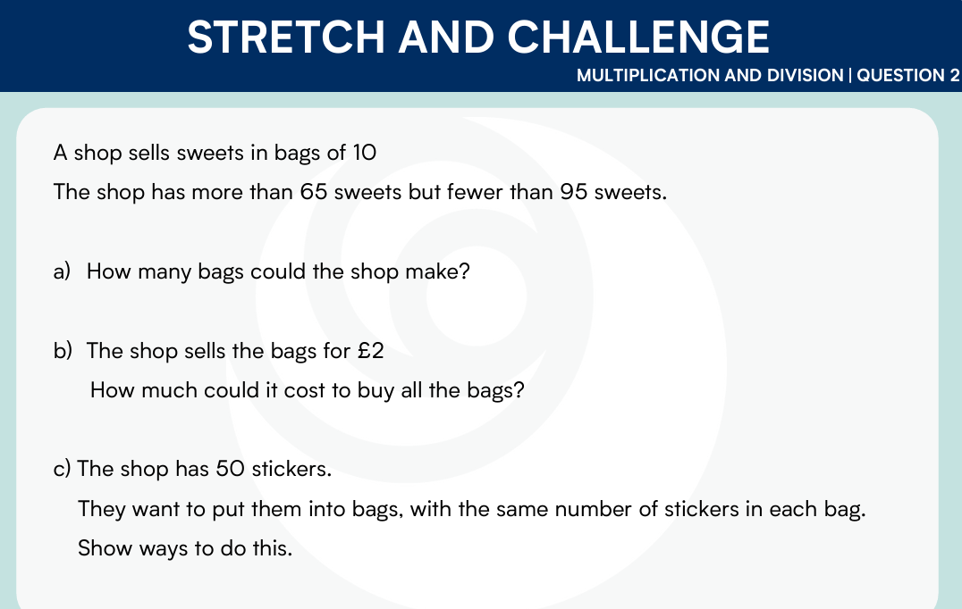

Slide 34
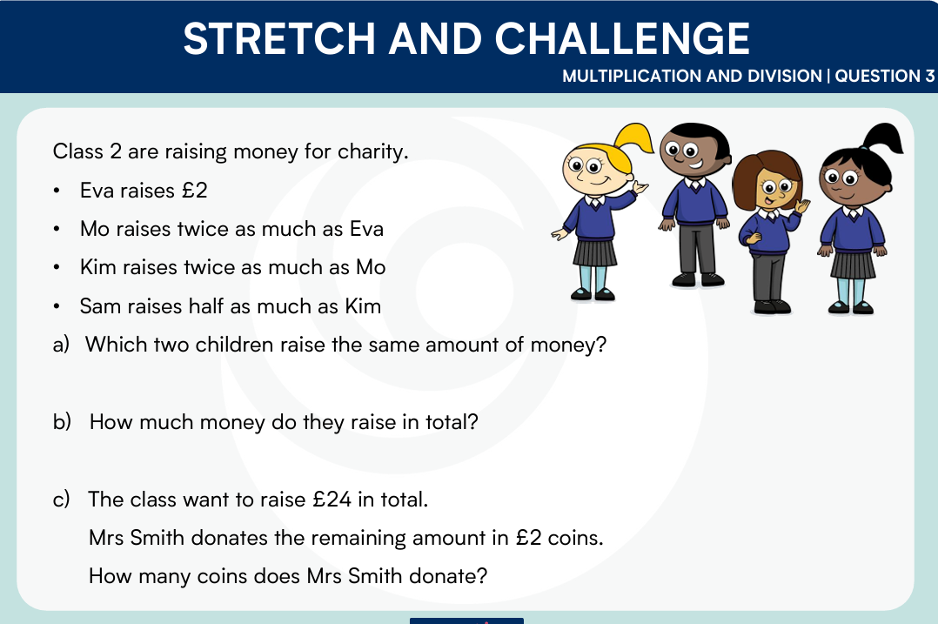

Slide 35
Any questions? Thank you for your time today
Monday 27th April 2026

