Slide 1
Year 2 Maths Parent Workshop
Monday 23rd September 2024

Slide 3
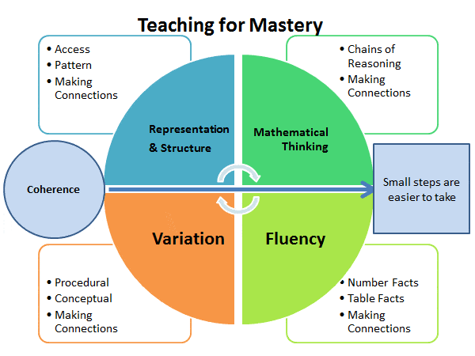
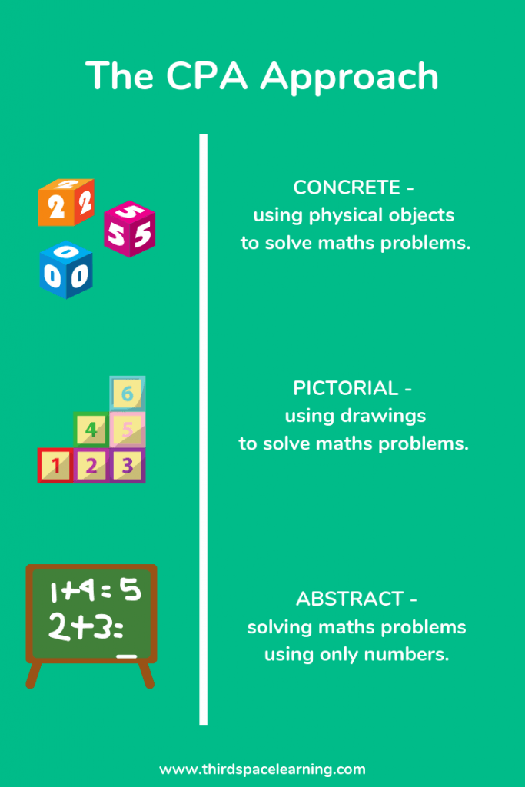
Useful websites:
White Rose Maths , Third Space Learning,
NCETM (National Centre for Excellence in the Teaching of Maths)

Slide 5
Concrete
This allows the children to use physical concrete manipulatives to support them with their maths skills. It will enable them to visualise and move the objects around which will help them to understand what they are doing and learning. It will bring the maths to life.

Slide 6
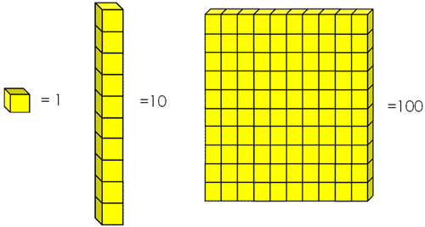

Slide 7
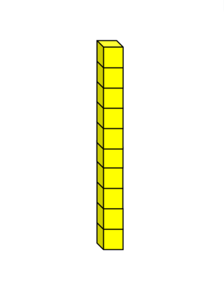
Can you show me 17 using Base 10?
What does the 1 in 17 mean?
What does the 7 in 17 mean?

Slide 8
Can you show me 24 using Base 10?
What does the 2 in 24 mean?
What does the 4 in 24 mean?

Slide 9
Can you show me 49 using Base 10?
What does the 4 in 49 mean?
What does the 9 in 49 mean?

Slide 10
Can you show me 36 using Base 10?
What does the 3 in 36 mean?
What does the 6 in 36 mean?

Slide 11
Pictorial

Slide 12
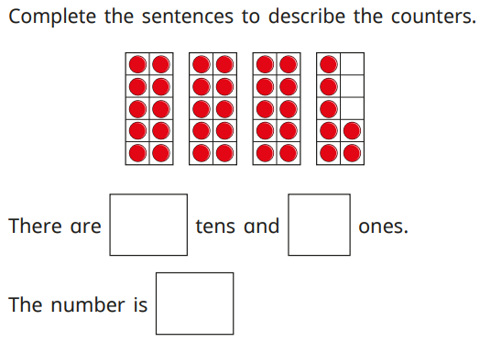

Slide 13
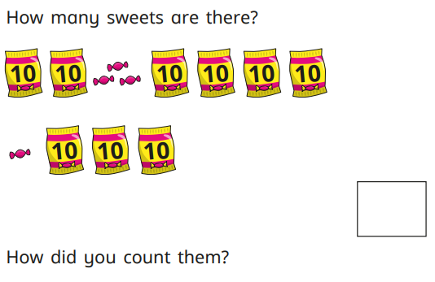

Slide 14
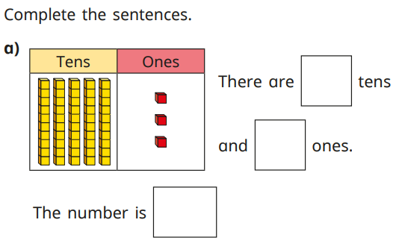

Slide 15
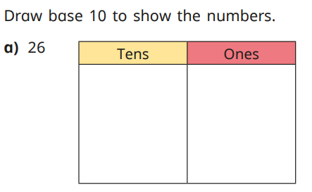

Slide 16
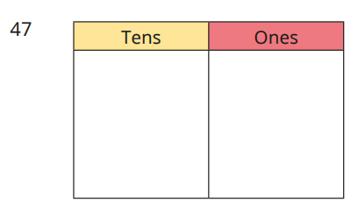

Slide 17
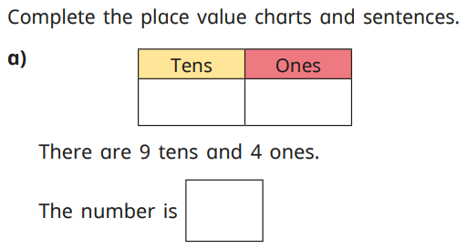

Slide 18
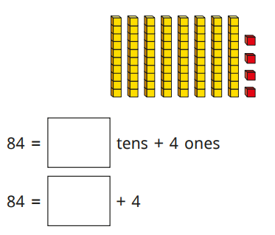

Slide 19
Draw these numbers if it helps to answer the question.
On your whiteboard, can you write how these numbers can be written in the expanded form?
28 52 84 46 35 41

Slide 20
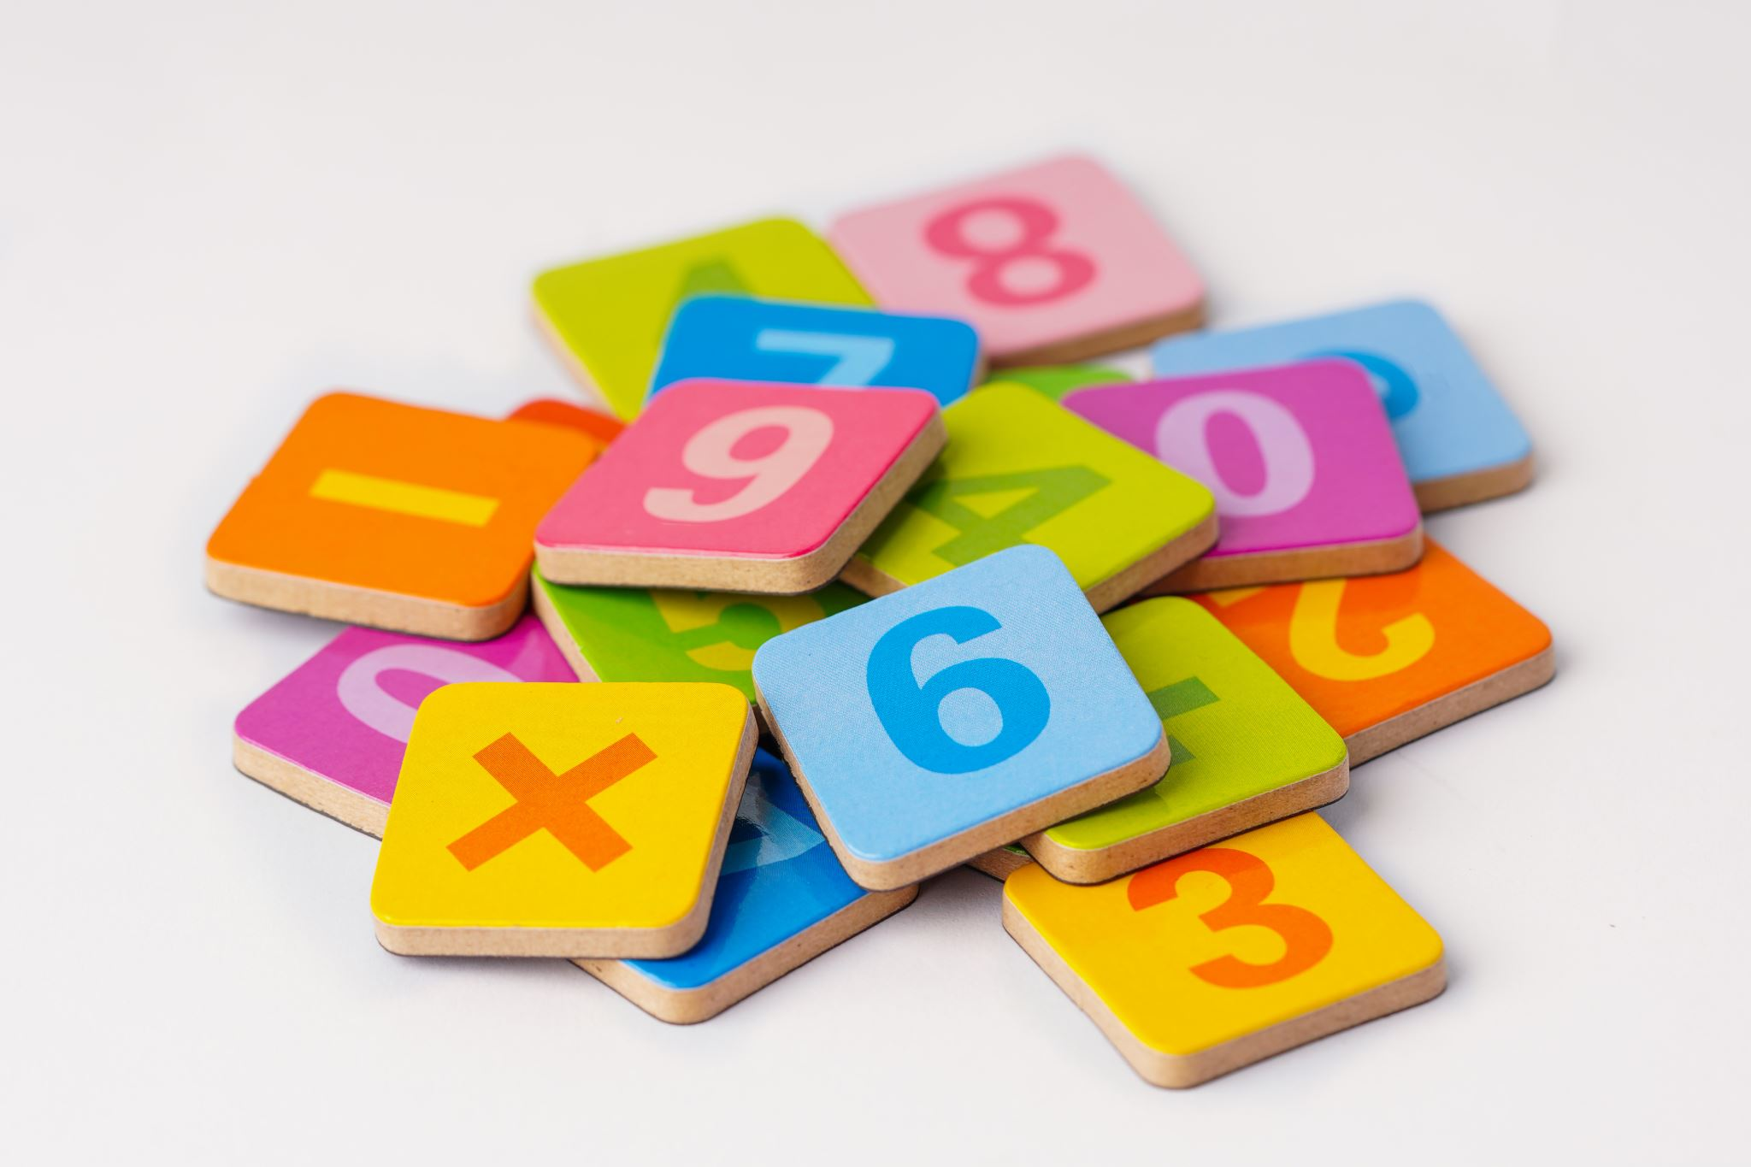
Once your child has grasped the basic skills of place value, they can move onto using these to answer number sentence questions. Our next block of learning will be addition and subtraction. We will apply these skills and have work through a few questions on the next slides.

Slide 21
Using Base 10, what is 16 + 13?

Slide 22
Using Base 10, what is 16 + 13?
After putting the tens together, and then the ones together, the child should be able to see the answer of 29

Slide 23
Try some of these questions:
23 + 14 =
36 + 22 =
25 + 24 =
42 + 17 =

Slide 24
Abstract
Using their knowledge of concrete and pictorial, they should be able to use these skills together.
For example, if it was place value, and you said the number 37, they should know that there are 3 tens and 7 ones, get them using concrete manipulatives and draw them pictorially too.
If you were at the abstract stage when e.g. solving addition and subtraction number sentences, your child should be able to solves these just using the numbers given. For example, 24 + 15 =

Slide 25
Maths skills
Fluency
The children need to be able to understand the concepts taught and use these skills to support their basic understanding of maths.
If they are fluent in the skill taught, they will be able to use these to move onto the next step of reasoning and problem solving.
Reasoning and Problem Solving
As the children are fluent in the skill taught, they can practise these to solve problems and give reasons.

Slide 26
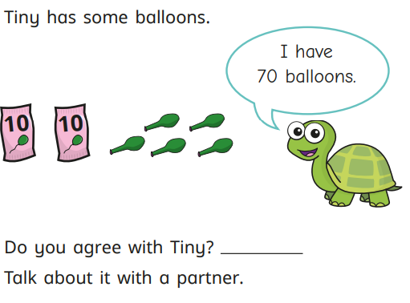
Reasoning and Problem Solving

Slide 27
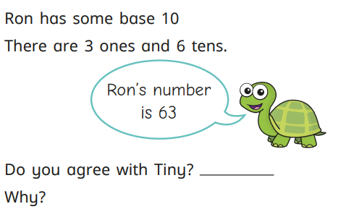

Slide 28
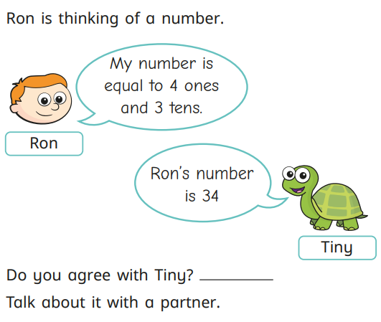

Slide 29
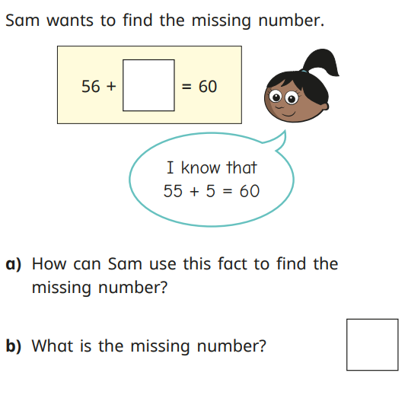

Slide 30
Any questions? Thank you for your time today
Monday 23rd September 2024

