Slide 1
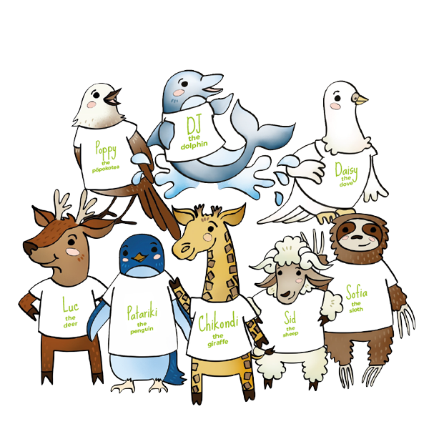
Catholic Social Teaching
prayers for Primary schools

Slide 2
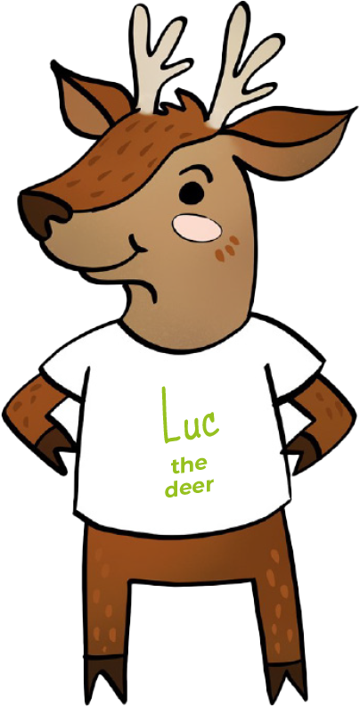
We believe
everyone
is special
Human Dignity

Slide 3
Loving God,
We believe that each person is special because God made us all.
Help us try to make sure all people are treated with respect and have what they need because God made them too.
Lord in your mercy
Hear our prayer
Everyone is special
Human Dignity

Slide 4
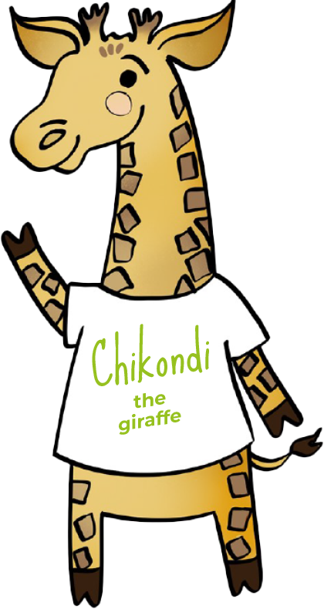
We believe in
thinking of
everyone
The Common Good

Slide 5
Loving God,
We believe that we are all brothers and sisters.
Help us to think about what is good for everyone, not just ourselves.
Lord in your mercy
Hear our prayer
Thinking of everyone
The Common Good

Slide 6
We believe in
taking part
Participation

Slide 7
Loving God,
We believe that everyone has special gifts and talents.
Thank you for the gifts you have given us.
Help us to make sure everyone can use the talents you gave them.
Lord in your mercy
Hear our prayer
Everyone is special
Human Dignity

Slide 8
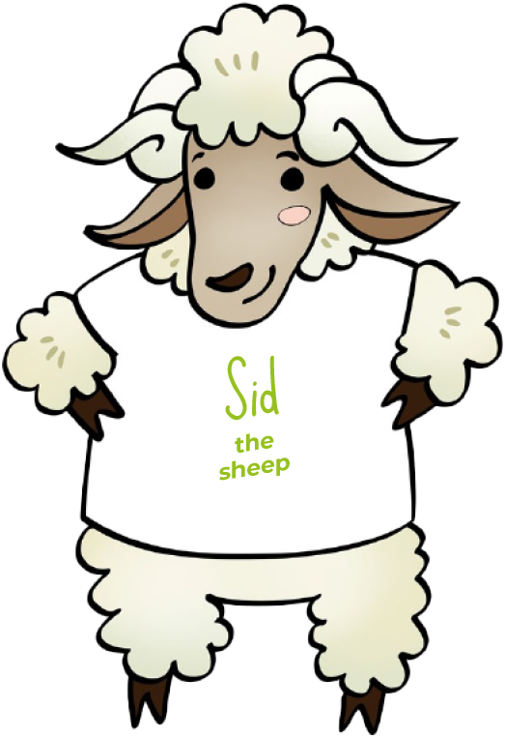
We believe
everyone should have a say
Subsidiarity

Slide 9
Loving God,
We believe that people who make decisions should listen to everyone.
Help us make sure everyone is treated fairly and can have a say.
Lord in your mercy
Hear our prayer
Everyone should have a say
Subsidiarity

Slide 10
We believe in
caring for
God’s gifts
Stewardship

Slide 11
Loving God,
We believe that the world is for everyone.
We thank you for the gift of Creation.
Help us to take care of the planet and all people who live on it.
Lord in your mercy
Hear our prayer
Caring for God’s gifts
Stewardship

Slide 12
We believe in
putting people
in most need first
Option for the Poor

Slide 13
Loving God,
We believe that when we serve the poor we serve you.
Help us to take special care of those people most in need.
Lord in your mercy
Hear our prayer
Putting people in most need first
Option for the Poor

Slide 14
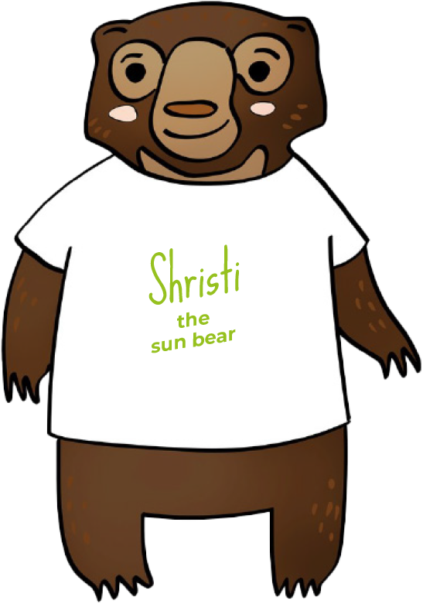
We believe in
showing we care
Solidarity

Slide 15
Loving God,
We believe that we are one big human family.
Help us to reach out to people who are suffering or sad, showing them the love you have shown
to us.
Lord in your mercy
Hear our prayer
Showing we care
Solidarity

Slide 16
We believe in
sharing fairly
Distributive Justice

Slide 17
Loving God,
We believe that the gifts of the world should be shared fairly.
Help us to always be grateful for what we have and share generously with others.
Lord in your mercy
Hear our prayer
Sharing fairly
Distributive Justice

Slide 18
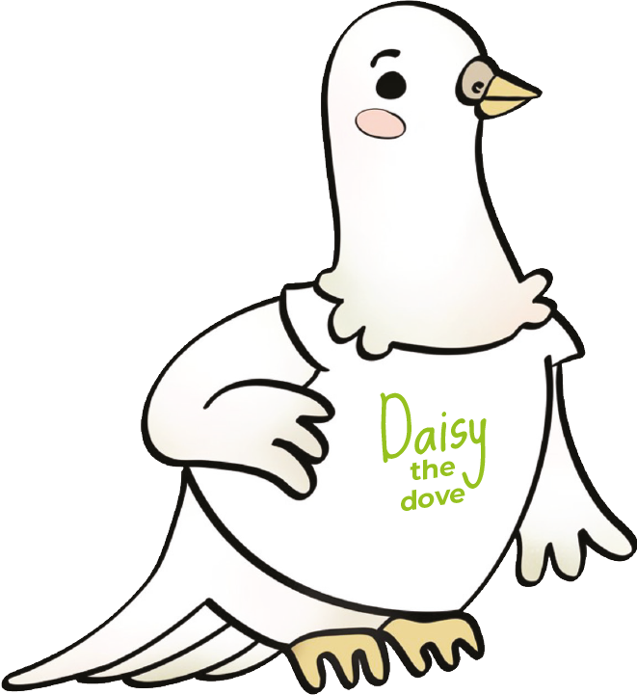
We believe in
being peacemakers
Promoting Peace

Slide 19
Loving God,
We believe you want to bring your peace to our homes, our communities and our world.
Help us to be peacemakers, listening to and loving each other.
Lord in your mercy
Hear our prayer
Being peacemakers
Promoting Peace

