Slide 1
We gather…
Laudato Si’
Caring for our common home

Slide 2
We gather…

Slide 3
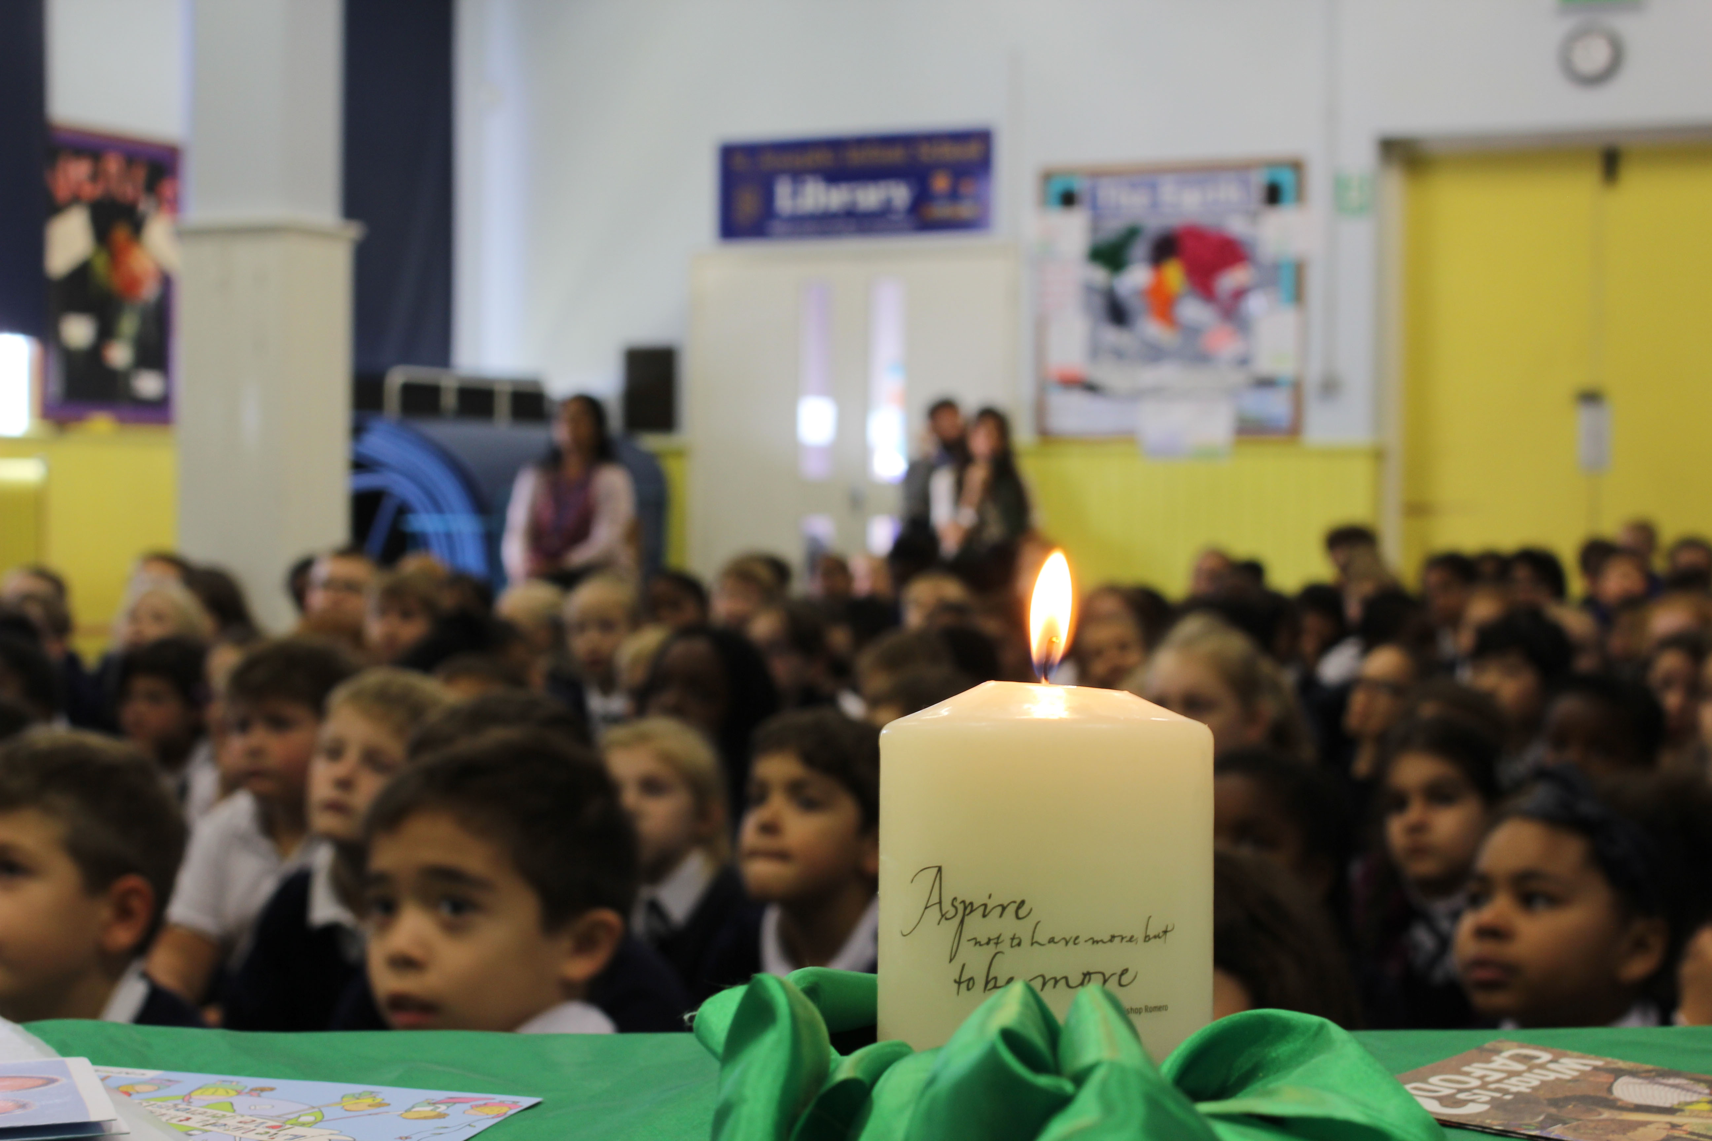
We listen…
A reading from the book of Genesis.
“God looked at everything he had made and was very pleased.”

Slide 4
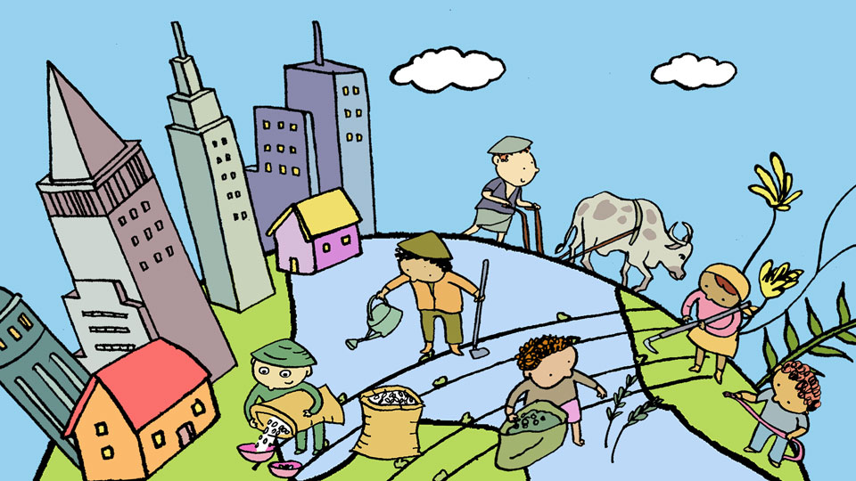
We listen…

Slide 5
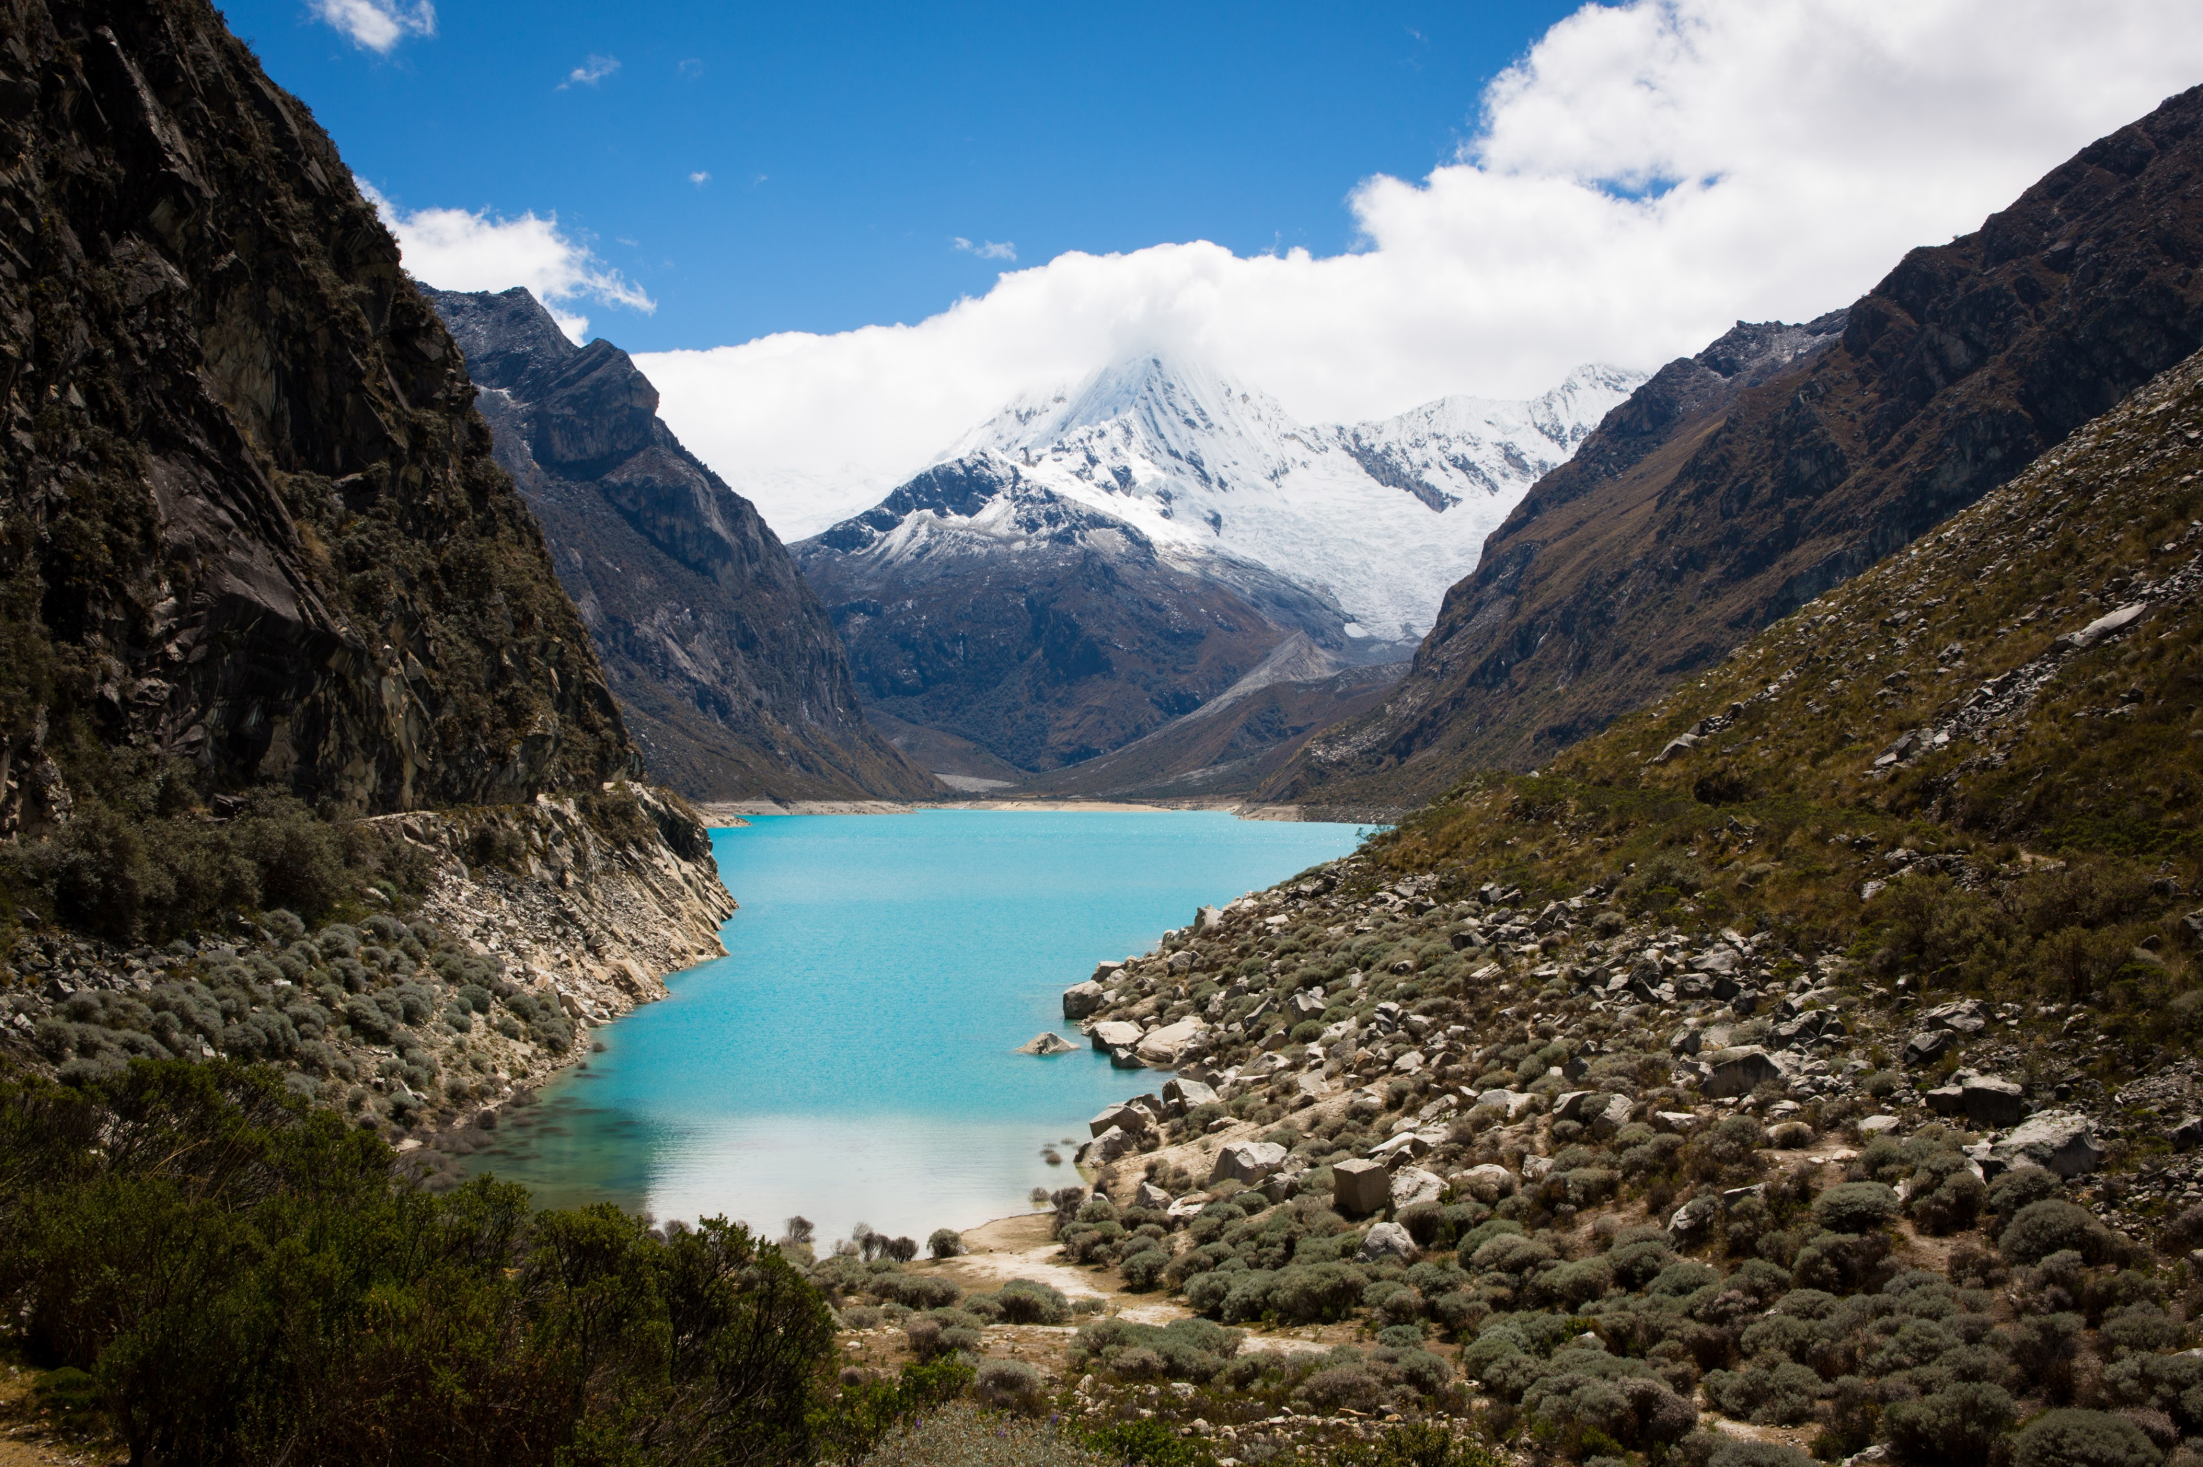
We respond…
Why do you think that God was pleased with the world?
What do you love about our world?

Slide 6
We respond…
Click the picture to watch the animation.
Notes:
Watch the animation here: https://www.youtube.com/watch?v=KOgF2Kgel6k

Slide 7
We respond…
What is Pope Francis asking us to do in his letter?
How does Pope Francis say we have treated the earth?

Slide 8
We respond…
What has happened to the earth because of this?
Why do you think Pope Francis wrote this letter?

Slide 9
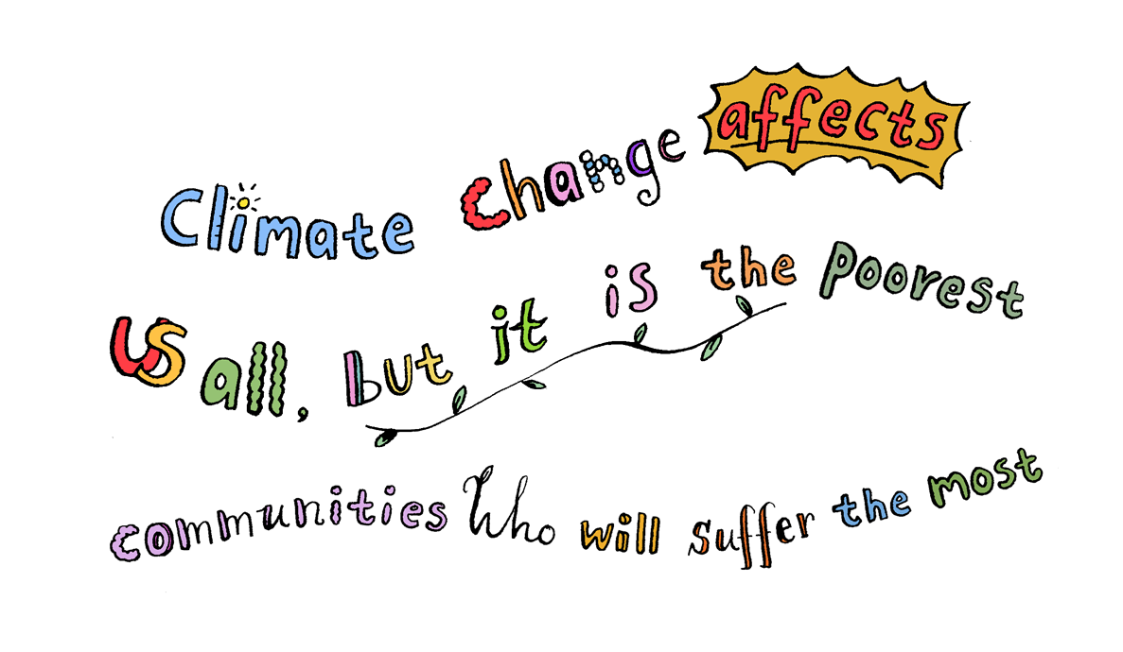
We respond…

Slide 10
We respond…
Will you be a
Zero Hero?
Notes:
Order Laudato Si’ postcards from shop.cafod.org.uk
Download Laudato Si colourig sheets to draw or write messages on from https://cafod.org.uk/content/download/29670/338396/version/1/file/Laudato_Si_Colouring_In_Sheet.pdf

Slide 11
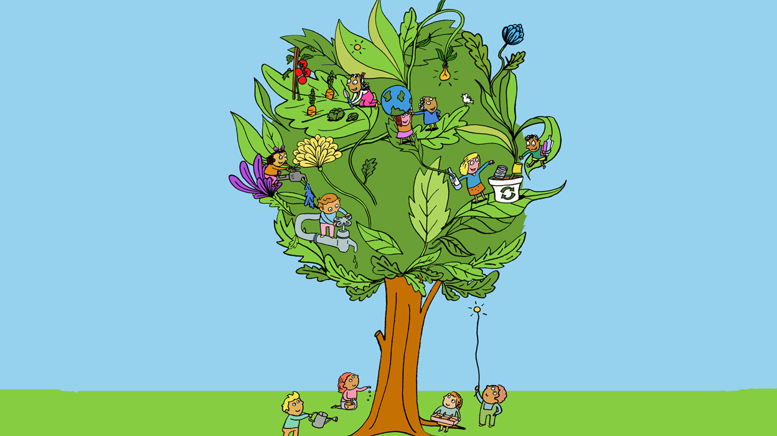
Going forth…
Lord in your Mercy…
Hear our prayer

